Slide 1
Update Briefing for B-17 Solar Farm
Presentation slides
15th Sep 2021

Slide 2
Agenda
To be covered as part of the presentation
Planning Application
    General update on application, highlighting any amends following statutory consultees.
    Landscaping strategy, what has been submitted, when will this be finalised, who has influence
    PROW (through the site/border the site)
    Committee date, we have been informed that our application will be heard on the 4th October 2021
Photomontages
    Update on logistics, there has been a delay in confirming the details via our consultants

Slide 3
B-17 Solar Farm
49.9MW Solar Farm application to at East Suffolk District Council
Located 1.2km to the west of Great Glemham and 1.5km east of Parham.
Supply renewable electricity directly into the local network.
Sensitively sited in a relatively isolated location.
Situated on 73.9 hectares (182.7 acres) of agricultural land that is currently used to grow animal feed crops.
Agricultural Land Grades
3a: 5Ha
3b 67Ha
Flood Zone 1 - land with less than a 1 in 1000-year chance of flooding in any given year

Slide 4
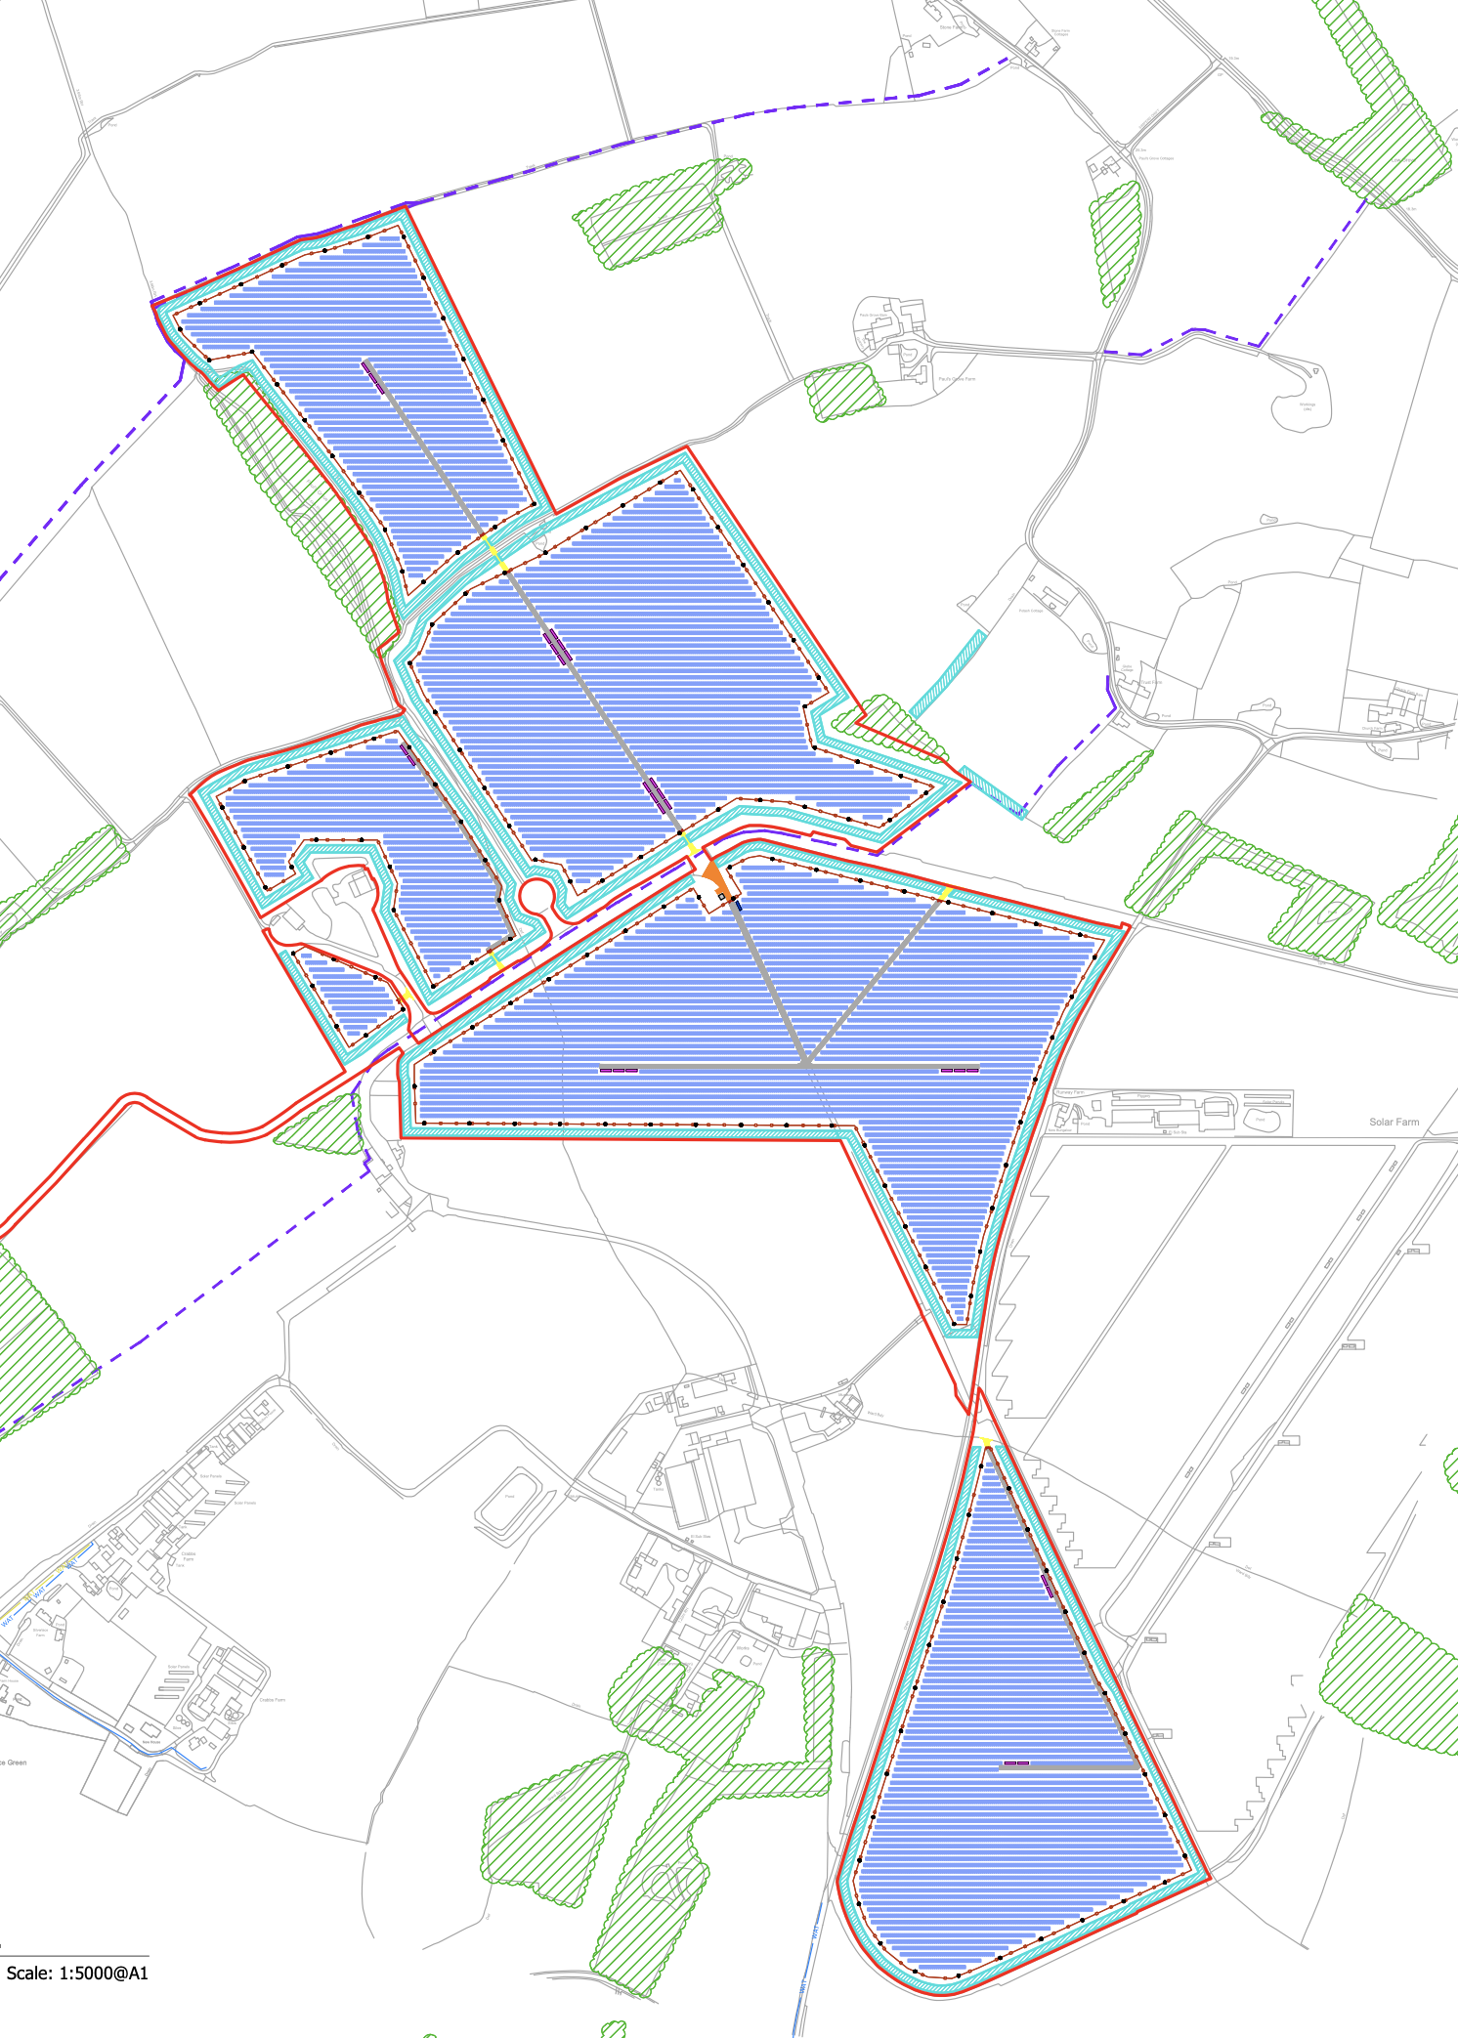
B-17 Solar Farm Planning Layout
Proposed Tree Planting
Proposed Hedge planting
Proposed Seed Mixes
Across the solar farm site
Public Right of Way Enhancements
Highway Verge
Landscape & Biodiversity Management Plan
Secured by planning conditions and agreed by officers

Slide 5
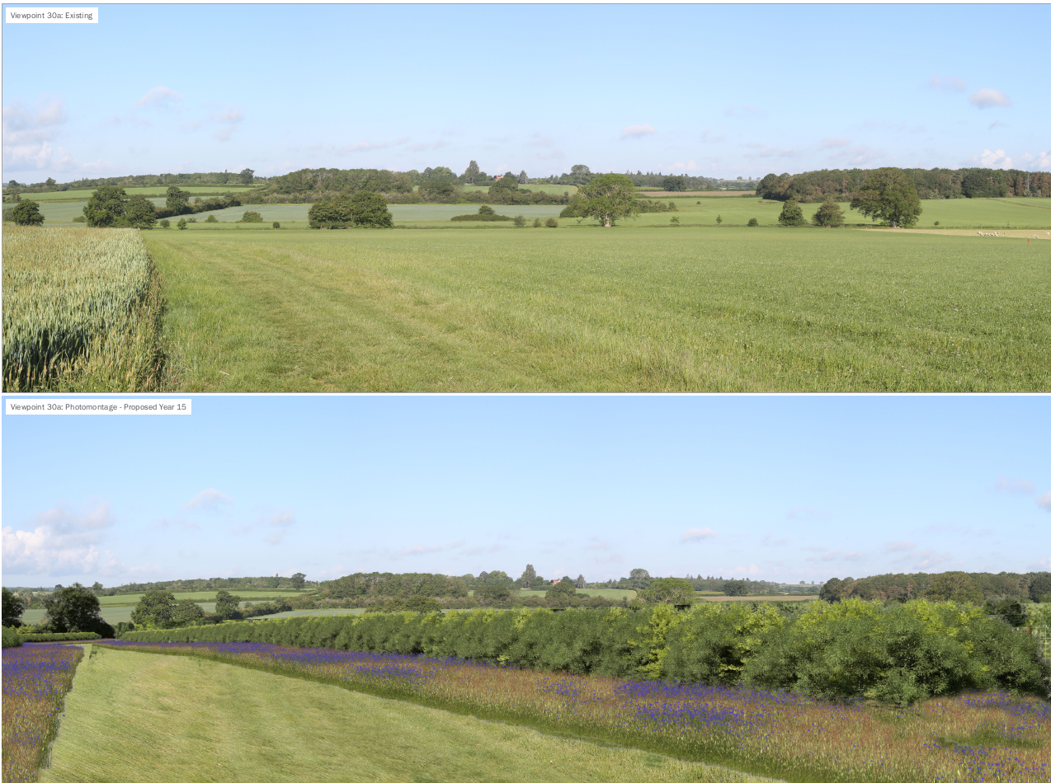
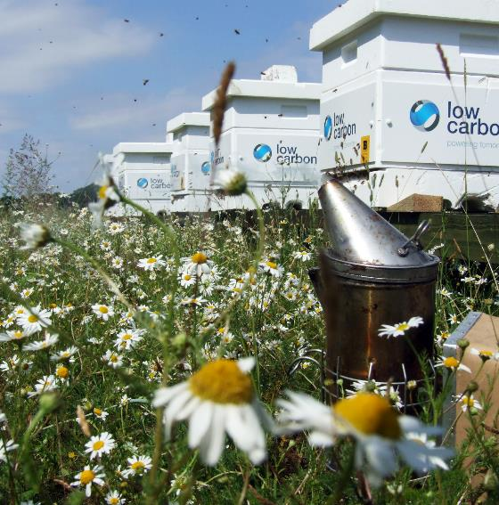
Biodiversity and PRoW
Biodiversity enhancements
Screening/Planting
Keeping Public Rights of Way open during construction
Preserving the enjoyment of those routes post-construction
Highway Verge, planting proximity

Slide 6
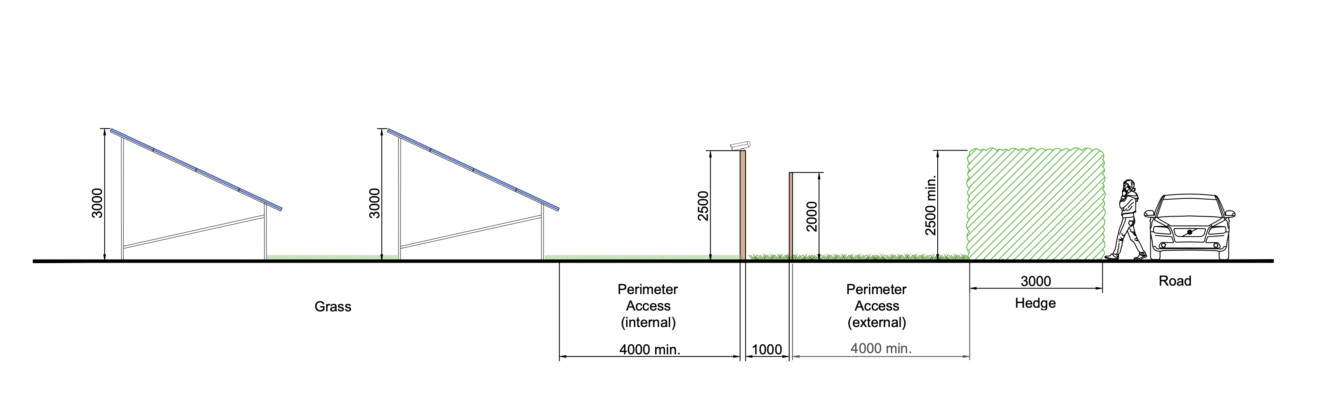
Cross Section (as shared)

Slide 7

View Point Photography
Photography Scheduled:
Friday 17th September
Location 2A
2 properties – take photos from both properties.
Location 3A
Take a photo from the back garden or upstairs.
Location 5A
Wide angles photos – up and down the road to show view to be experienced by motorists
Location 6A
PRoW photos
1a
4a
2a
3a
6a
5a

Slide 8
Statutory Consultation Update
Natural England No Objection
SCC Public Rights of Way No Objection
Ecology No Objection
SCC Highways No Objection
Suffolk Wildlife Trust No Objection
Flood and Water Management No Objection Amended Drainage Strategy
County Archaeologist No Objection
Arboriculture and Landscape Manager No Objection
Parham Parish Council No Objection
Hatcheston Parish Council No Objection
Great Glemham Parish Council Objection
Marlsford Parish Council Objection
Design and Conservation Consultation Response No Objection
East Suffolk Drainage Board No Objection
Environmental Protection No Objection
Suffolk Coasts & Heaths No Objection
Suffolk Preservation Society Objection (Non statutory group)
Environment Agency No Objection
National Grid- Cadent Gas Limited No Objection
Historic England No Objection

Slide 9
Next Steps
Take Photographs from agreed view points
    Select photography suitable for photomontages
    Presentation of montages to Great Glemham Parish
The Case Officer has Scheduled the Planning Committee Date
    4th of October 2021
Community Benefit
    Arrangement between Low Carbon and Parish

Slide 10
Questions

