Slide 1

Notes:
Welcome and introductions

Slide 2
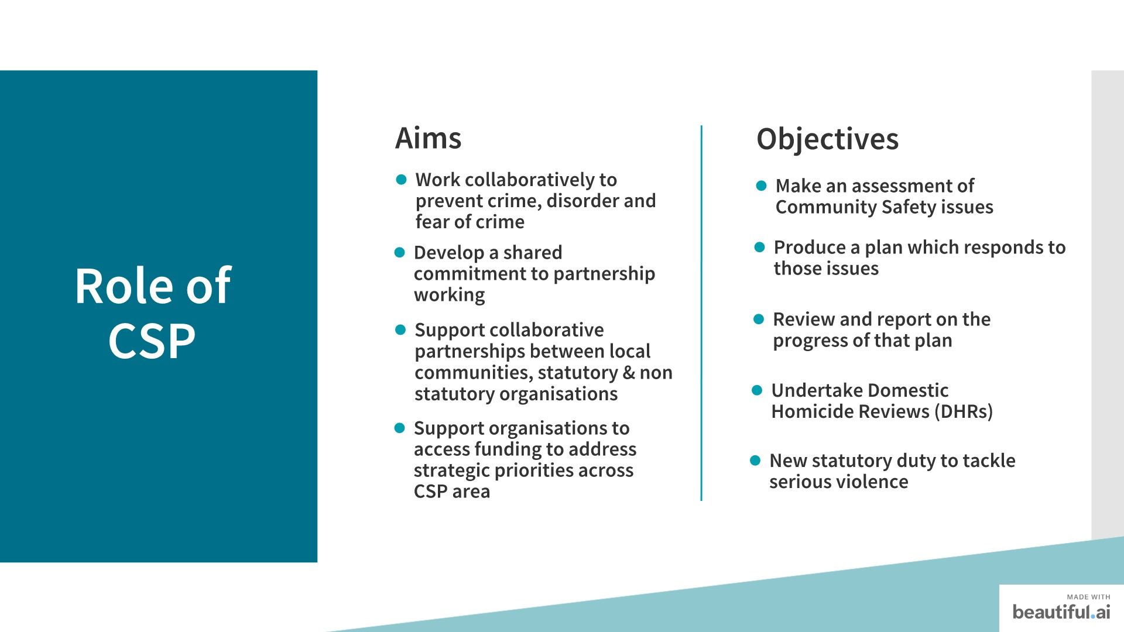

Notes:
These are the key aims and objectives of the CSP.
The Aim of the CSP is to meet the statutory requirements of the Crime and Disorder Act 1998 and subsequent legislation.
They work collaboratively to prevent and reduce crime, disorder and the fear of crime, following an evidence-based approach, to promote the sharing of good practice and divert people away from crime and anti-social behaviour. To promote a wider understanding of the contributions and responsibilities of individual agencies and develop a shared commitment to partnership working.
To encourage and support collaborative partnerships between local communities, statutory and non-statutory organisations. To support non-statutory, voluntary and community groups.in accessing funding to deliver community safety projects that address the strategic priorities across the East Suffolk CSP area. East Suffolk CSP is a statutory body with responsibility to: Make an assessment of community safety issues. This is known as a Strategic Assessment. The completion of an annual Strategic Assessment is a statutory requirement for CSPs. The purpose of the Strategic Assessment is to assist the Partnership in understanding the patterns and trends relating to crime, disorder, anti-social behaviour and community safety issues affecting the East Suffolk CSP area and to help identify which crime and disorder priorities to focus on in the coming year In order to identify emerging issues, this Strategic Assessment includes a comprehensive analysis of the level and patterns of crime, disorder and offending across the East Suffolk CSP area. The aim of this document is to provide the East Suffolk CSP with the most up to date evidence in order to set strategic priorities for the forthcoming year and informs the development and revision of a rolling 3-year Partnership Plan to address those priorities. Since 2011, CSPs have a statutory duty under Section 9(3) of the Domestic Violence, Crime and Victims Act to undertake Domestic Homicide Reviews (DHRs). A Domestic Homicide Review means ‘a review of the circumstances in which the death aged 16 or over has, or appears to have, resulted from violence, abuse or neglect by- (a) a person to whom he was related or with whom he was or had been in an intimate personal relationship, or (b) a member of the same household as himself, held with a view to identifying the lessons to be learnt from the death. The purpose of a DHR is to: a) establish what lessons are to be learned from the domestic homicide regarding the way in which local professionals and organisations work individually and together to safeguard victims; b) identify clearly what those lessons are both within and between agencies, how and within what timescales they will be acted on, and what is expected to change as a result; c) apply these lessons to service responses including changes to inform national and local policies and procedures as appropriate; d) prevent domestic violence and homicide and improve service responses for all domestic violence and abuse victims and their children by developing a coordinated multi-agency approach to ensure that domestic abuse is identified and responded to effectively at the earliest opportunity; e) contribute to a better understanding of the nature of domestic violence and abuse; and f) highlight good practice. To date East Suffolk CSP has undertaken 4 Domestic Homicide Reviews, 2 of which are completed and published, 1 of which was deemed not to be a DHR but rather a local review and 1 which is currently with the Home Office Q & A Panel for review. The last DHR will not be for publication. The cost of employing an Author and Overview Report Writer and the cost of any local authority additional administrative provision in the District where the DHR is being conducted, has been fully funded by the CSP. The East Suffolk CSP commissioned a DHR workshop for Countywide partners in 2017 to review lessons learnt from DHR’s from across the County. In July 2019, the Home Office announced a new duty on public bodies to tackle serious violence. The new public health duty covers Police, local councils, local health bodies such as the NHS Trusts, education representatives and youth offending services. It will ensure that relevant services work together to share data, intelligence and knowledge to understand and address the root cause of serious violence including knife crime. It will also allow them to target their interventions to prevent and stop violence altogether. In addition, the Government will amend the Crime and Disorder Act to ensure that serious violence is an explicit priority for Community Safety Partnerships, by making sure they have a strategy in place to tackle violent crime. We are yet to gain a greater understanding of how this will look for CSPs in Suffolk.

Slide 3
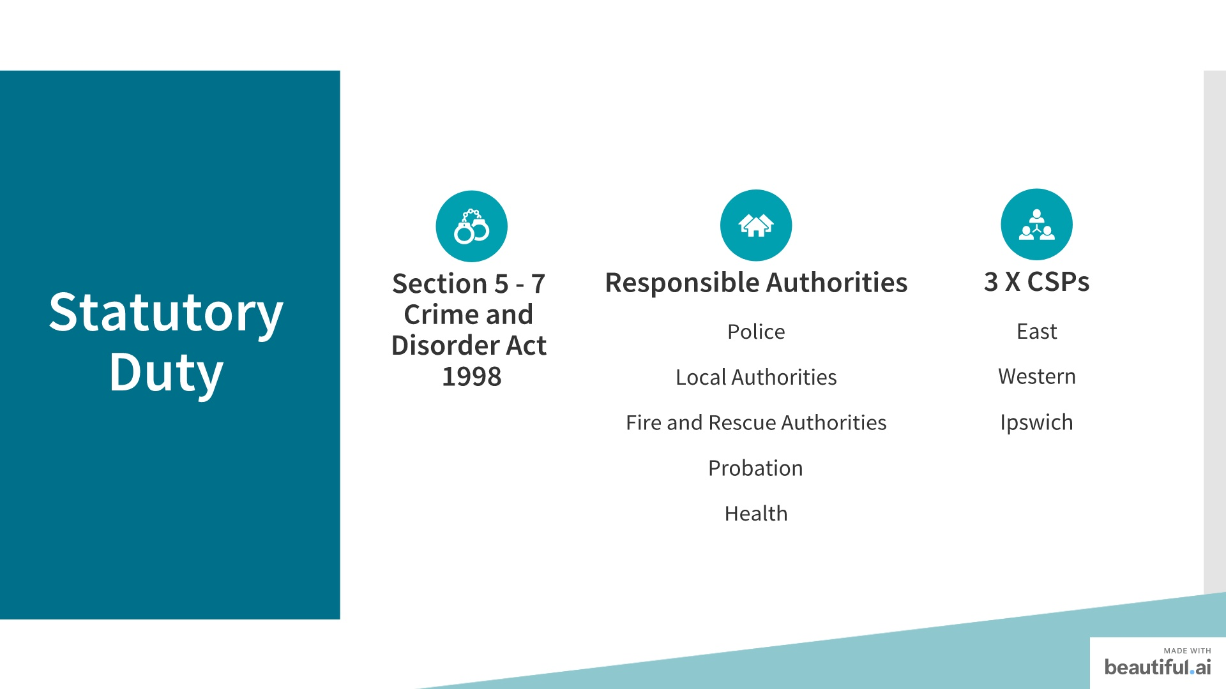
Notes:
Community Safety Partnerships were set up under Section 5-7 of the Crime and Disorder Act 1998. In statute they are called Crime and Disorder Reduction Partnerships (CDRPs), however they are known as Community Safety Partnerships or CSPs.
In Suffolk there are 3 CSPs, Western which includes West Suffolk Council (formerly Forest Heath and St Eds) and Babergh and Mid Suffolk District Council areas, East CSP covers East Suffolk Council areas (formerly Waveney and Suffolk Coastal) and Ipswich covers the Ipswich Borough Council area.
CSPs are made up of statutory representatives from East Suffolk Council, Suffolk Fire Service, Suffolk County Council, Suffolk police Probation and the Clinical Commissioning Group (CCG). East Suffolk CSP has co-opted members from Housing, Crimestoppers, Town & Parish Councils and others that add valuable knowledge and expertise to the partnership.
These partners work together to protect their local communities from crime and to help people feel safer.
In addition to the statutory agencies of the partnership working together, we also have strong links with Police and Crime Commissioner (PCC) who is fully supportive of CSPs and their work and in turn, CSPs have a duty to take due regard of the Police and Crime Commissioner’s Police and Crime Plan. The ESCSP plan reflects those issues in the PCP which result in producing the greatest threat, risk and harm to our communities. The CSP s also have strong links with the Safer Stronger Communities Group (SSCG) which we will explain later in the presentation. Each CSP has a Terms of Reference which is reviewed annually along with the membership.

Slide 4
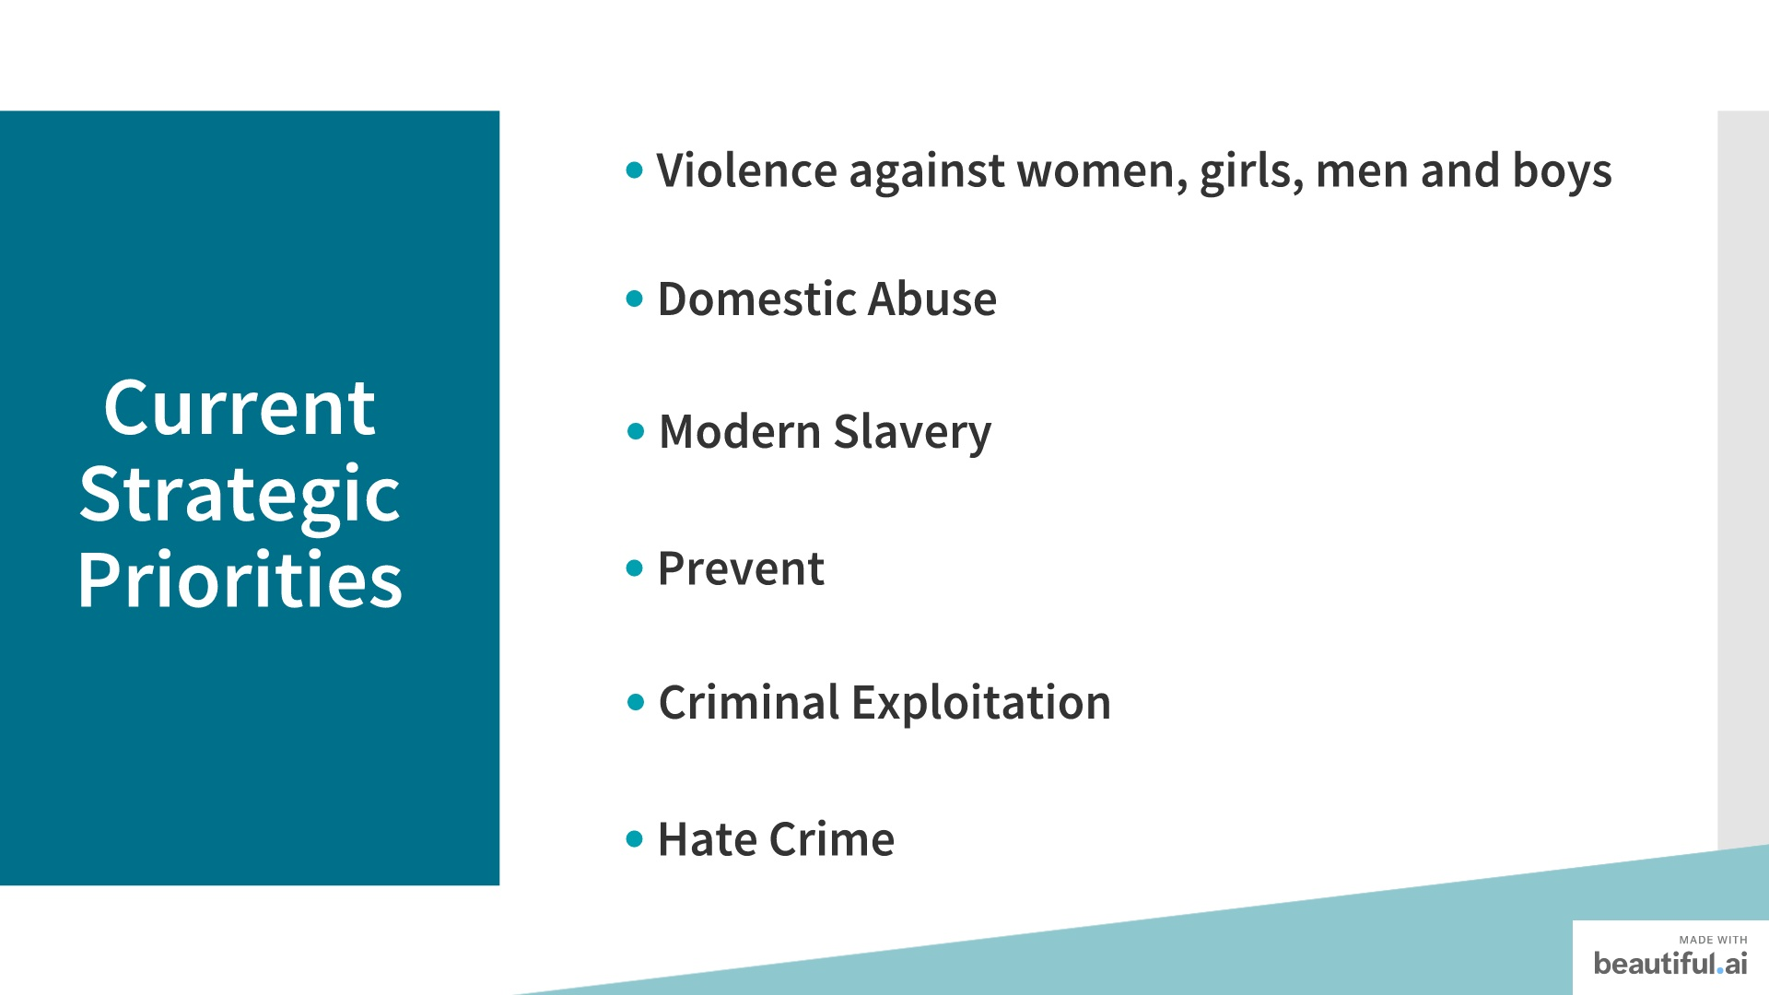
Notes:
The Strategic Priorities of East Suffolk CSP; comes under four activity themes:
Awareness Raising: VAWG Hate Crime and Prevent
Communication: VAWGMB by supporting all national campaigns
Training and Education: Hate Crime
Projects: VAWGMB, Modern Slavery.
Prevent is about supporting and protecting those that might be susceptible to radicalisation and extremism. There is a Prevent Delivery Group who have developed a Strategy and Action Plan and a Prevent Conference was held in April 2019. In addition, over 80 practitioners from a wide range of organisations across Suffolk are trained to deliver Workshop to Raise Awareness of Prevent (WRAP) training sessions. Training commenced in January 2015 and over 8,000 people have attended a workshop. Anti-Social Behaviour is tackled through local multi-agency operational groups and forums which take place in each of the Districts addressing referrals relating to individuals/families/locations on issues including neighbour disputes, mental health, substance misuse, vulnerable people and homelessness. In relation to the Urban Street Gangs and County Lines priority and in response to the increase in gang and drug-related violence amongst vulnerable young people in Ipswich in 2017, research was commissioned into the issue of County Lines and Gangs to inform a partnership response and a Suffolk Strategic Action Plan was developed. Each CSP area developed a Tactical Action Plan (TAP), which reflected the Strategic Action Plan, and contains five workstreams with specific activity under each workstream that will deliver the outcomes for that CSP area. The TAP is a restricted document and is not in the public domain.
We are now moving into a transition phase before starting on a new 3-year work programme on Criminal Exploitation (previously Urban Street Gangs and County Lines). The action plan will commence in April 2021, however, new activities around Prevention and education, Intervention and exit, Leadership, enforcement, innovation, community response and contextual safeguarding are already being developed. VAWGMB. Violence Against Women and Girls Men and Boys Strategy 2018 - 2021 has been developed along with an Action Plan which is being overseen by a Joint Commissioning Group. In addition, there are various other funded Domestic Abuse projects and initiatives are underway to tackle domestic abuse which we will explain later.
Modern Slavery is a new priority for all 3 CSPs in Suffolk. Projects to deliver the Modern Slavery priority include raising awareness amongst CSP members and frontline staff in a wide range of agencies and organisations across Suffolk.
In addition, to encourage local businesses and forums to report potential Modern Slavery, we will deliver Modern Slavery awareness raising to key local business to encourage reporting. DHRs we talked about in the previous slide. The ESCSP works to support community/voluntary groups to secure funding to deliver projects/initiatives which meet an identified community safety issue, which are a threat or risk or will cause the greatest harm to the community.

Slide 5
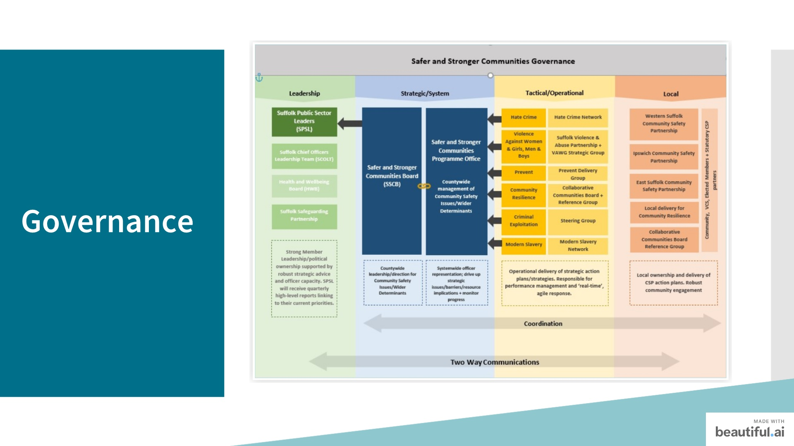
Notes:
This slide details the current Governance Structure for the Safer Stronger Communities Group (SSCG). You can see how the CSPs link into the SSCG. This group gives the countywide direction for all community safety issues and feed into Suffolk Public Sector Leaders and Community Safety Partnerships. Community safety is a key determinant for health and wellbeing and this tactical county wide group has been developed with an aim to give a light touch coordinated response, with a view of getting a better understanding of the whole picture in community safety, drawing agendas together, identifying gaps and responding. Communication with the CSP is vital if they are to deliver locally which is where they are best placed to carry out community engagement. CSP chairs are members of the SSCG. The 6 key priorities for the SSCG are as follows: Hate Crime Violence Against Women and Girls Men and Boys •Prevent •Community Resilience •Criminal Exploitation •Modern Slavery These priorities are reflected in the strategic priorities of the ESCSP.
For all areas of prioritisation within the ESCSP Action Plan, a calendar of events for proactive promotion and communication is recommended. As well as the CSP supporting national campaigns, we will also identify key events within our organisations and communities where we are able to raise awareness of Community Safety issues and promote the work of the CSP The action contained in the Action Plan could be timed for launch with the national campaigns where possible for maximum impact. Work with local DA forums on DA and SV campaigns to maximise impact
The Safer Stronger Communities Group (SSCG) and Suffolk Public Sector Leaders (SPSL) provide funding to support key projects/initiatives to deliver the strategic priorities, some of which will be explained in the next slide.

Slide 6
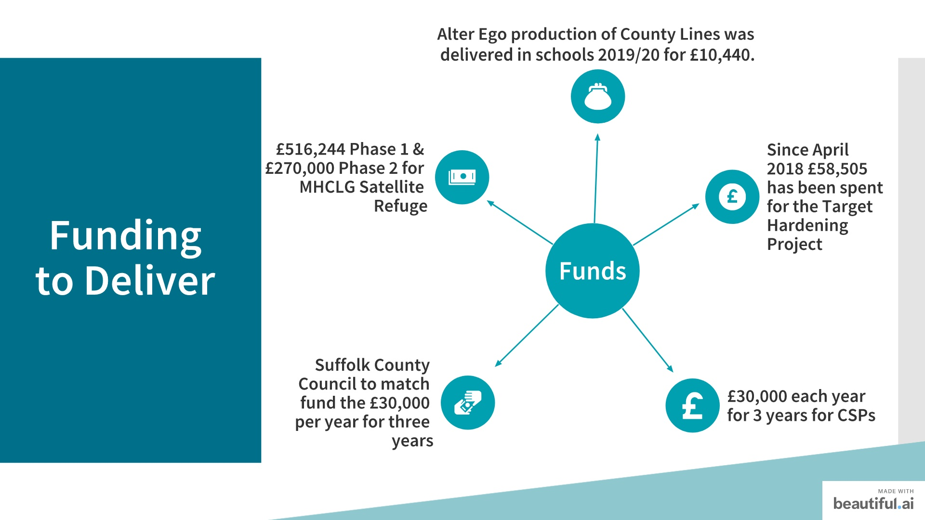
Notes:
Suffolk CSPs do not receive funding from the Police and Crime Commissioner (PCC), to commission services and award grants that contribute to the CSP Strategic Priorities as PCC funding ceased in March 2014.
From April 2014, the PCC devolved the Home Office Crime and Disorder Grant to Suffolk Community Foundation (SCF) as the Safer Suffolk Fund (SSF). Bids to the fund can be made by community and voluntary organisations but not by statutory bodies including CSPs. Community Safety Partnerships can support these organisations with applications to access funding from SCF to deliver community safety projects and initiatives that address the CSPs strategic priorities. However, a number of projects/initiatives have received funding from the Safer Stronger Communities Group, Suffolk Public Sector Leaders, Suffolk County Council Localities and Partnerships team, Suffolk Police and Crime Commissioner, District and Borough Councils and a successful application to the Ministry of Housing, Communities and Local Government. Suffolk Target Hardening Project
Partners across Suffolk have contributed to this project which has seen significant benefits for high risk domestic abuse victims and has contributed to victims being able to stay safe in their own homes.
Since the start of the project in April 2018 £58,505.00 has been spent with 262 homes receiving home security measures at an average cost of £223.30 per home. There is an annual pooled pot of £13,750. The top 5 Registered Social Landlords (RSLs) have been approached in relation to contributing towards the pooled funding.
Domestic Abuse Co-ordination Centre Model
The national charity SafeLives has helped to develop Suffolk’s thinking around our aspiration for a Suffolk Domestic Abuse Co-ordination Centre. This identified the need to divide the work into three distinct workstreams that would allow us to progress towards achieving the overarching ambition to ensure everyone knows how and where to get help, that they get the right advice and help first time to avoid duplication and waste in the system and that we put systems in place to better understand demand and use this to inform where we target resources.
The Domestic Abuse data and information project led by the Suffolk Office of Data Analytics (SODA) is already underway and making progress in capturing data from public services and providers. In time, it will help us better understand demand. It will also explore the possibility of providers using a shared case management system so that we can work better across organisations, systems and geographies.
Commissioning processes have been aligned, we have introduced shared contract management arrangements and a mechanism to improve pathways between the 3 main Domestic Abuse service providers in Suffolk. There are further opportunities next year to integrate the refuge accommodation/satellite provision into these arrangements so that we continue to improve and join up wherever possible.
The third workstream will explore how victims, family, friends, perpetrators access the right help, first time. A big part of this will also be awareness raising to ensure everyone knows what that route is and become as familiar with it as possible. Throughout Covid-19 the system has come together to promote one 24/7 freephone helpline which give us a good foundation on which to build.
In the Spring 2017 SCC working in partnership with district and borough colleagues were successful in receiving £516,244 funding from MHCLG to provide satellite accommodation for victims with complex mental health and substance dependency needs. This funding was devolved to district and borough councils who entered into local arrangements with providers. The accommodation was available from January 2018 and with an additional successful application for £270,000 we have managed to keep this provision until December 2021.
Anglia Care Trust Supported by SCC were successful in receiving funds from MHCLG to provide an additional 7 bed spaces as a response to Covid-19 and increasing pressures on temporary accommodation. MHCLG funding was for an initial 6 months with SCC supporting the increased capacity for a further 6 months.
As an indication we have seen a 25% increase in people seeking support to the Domestic Abuse Outreach Service and although not all will seek refuge we are seeing more complex clients with mental health and substance dependency needs present who wouldn’t be able to access communal refuge and where satellite provision is more appropriate but limited.
Public Health Suffolk have agreed to extend all Satellite provision through to the end of March 2022.
In June 2018, Suffolk Public Sector Leaders (SPSL) agreed to fund Community Safety Partnerships to progress actions locally that contributed to delivering the priorities of the SSCG. The total amount available each year for three financial years (2018 – 2021) is £30,000 which was divided across each CSP area based on population data. All CSPs are in receipt of the full funding (for the full three years). Activity and spend for each CSP is monitored by the SSCG by way of quarterly updates. As part of the 2018 SPSL agreement, Suffolk County Council agreed to match fund the £30,000 per year for three years and this was passported to the SSCG to deliver against its priorities in 2018/2019, 2019/2020 and 2020/2021. East Suffolk CSP did put aside £6000 toward delivery of Crucial Crew+ but due to Covid 19 was unable to proceed. A digital package is currently being developed.
A successful workshop by Tony Saggers was delivered to partners in October 2019 with a cost of £700.
Alter Ego production and dramatization of County Lines was delivered in Schools 2019/20 £10,440.
Junior Smart delivery of two workshops on Criminal Exploitation December 2020 and January 2021 £1,100.

Slide 7

Notes:
Every local authority has the power to scrutinise CSPs through a number of pieces of legislation including The Police and Justice Act 2006, Sections 19 and 20 of the Crime and Disorder Act 1998 and the Crime and Disorder Overview and Scrutiny Regulations 2009 (and statutory guidance) powers for scrutiny of crime and disorder and Councillor Call for Action (CCfA). These require that each local authority has in place a committee with power to review and scrutinise and make reports or recommendations regarding the functioning of the Responsible Authorities. This legislation forms part of the Government’s commitment to strengthen the accountability of CSPs and enhance the role of local Councillors and local communities in preventing and reducing crime. The local authority representative on the ESCSP produces a report on the work of the partnership over the past 12 months and planned work going forward, ahead of the O & S meeting.

Slide 8


Slide 9

Notes:
That concludes our presentation. Thank you for your time and do you have any questions?

